Slide 1








What is
Neural
Network
Deep learning

Slide 2



Can you find number three?

Slide 3
Can you find number nine?

Slide 4


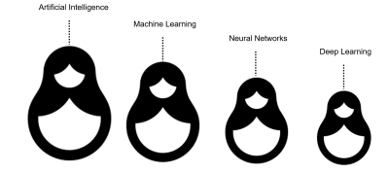




Deep learning
Notes:
A method in Artificial Intelligence that teaches computers to process data in a way that is inspired by the human brain. allowing computer programs to recognize patterns and solve common problems.
Recognize patterns like face ID recognition
Solve common problem like spam email
Neural network is base of deep learning
And sub field of machine learning
also inspired by artificial intelligence

Slide 5




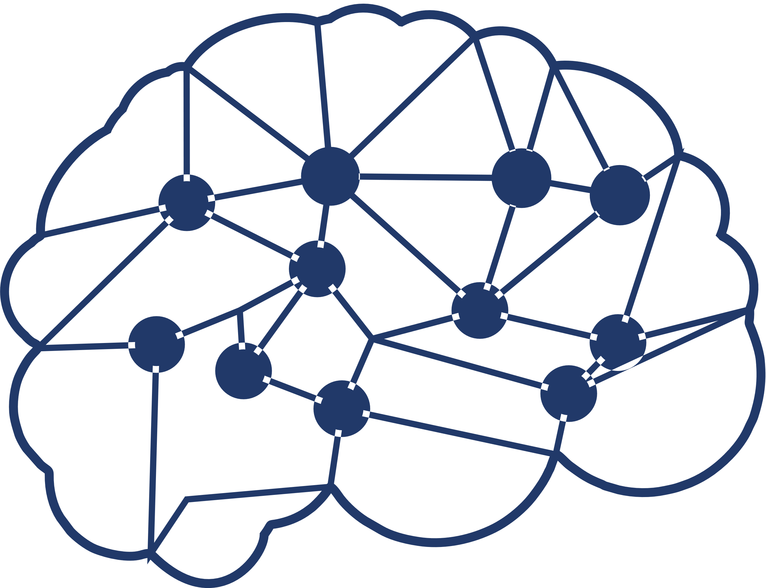
Prime Applications of NN
Facial recognition
Forecasting
Music composition

Slide 6
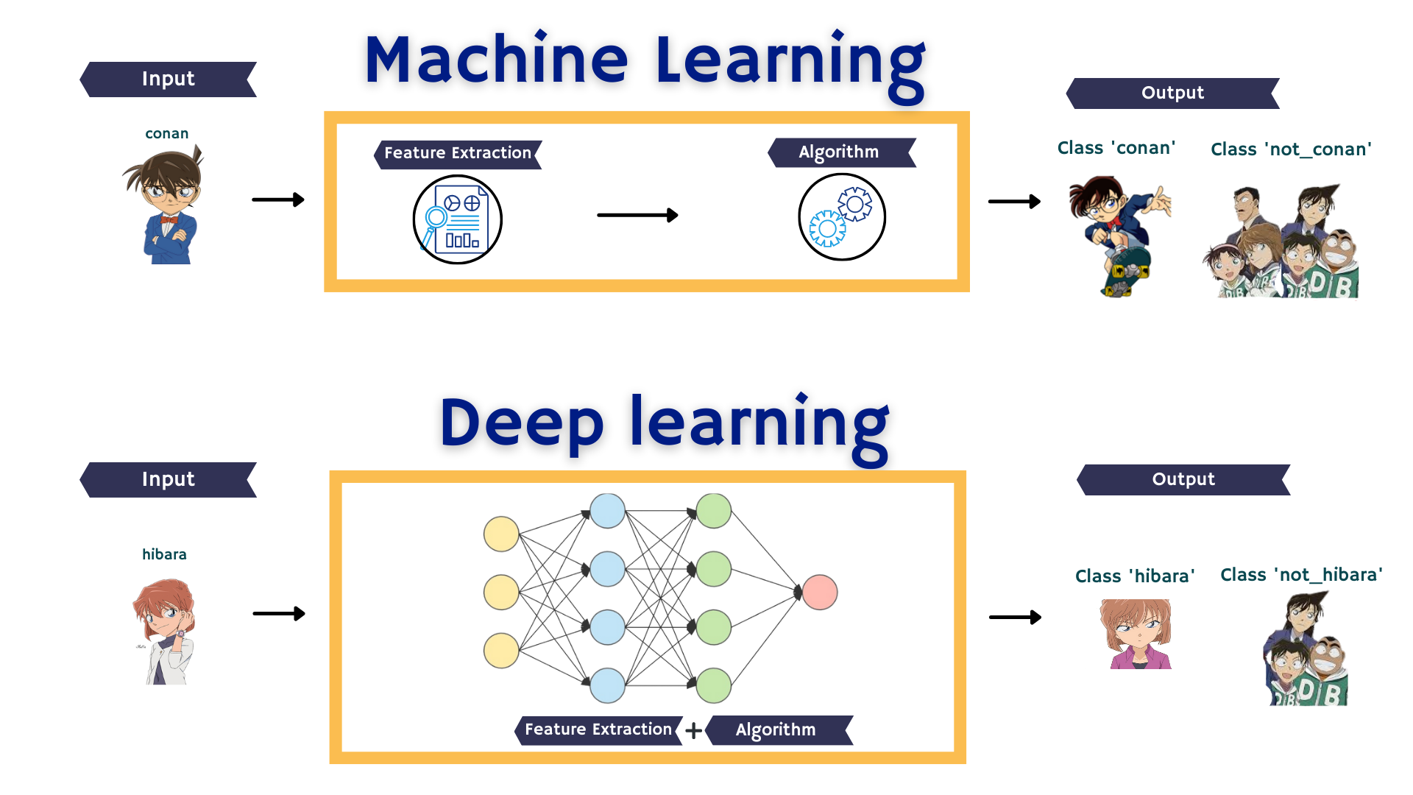

Slide 7

What is Artificial neural networks (ANNs)
Neural network is layers of neurons.
Neurons are core processing unit of the network.
There are 2 main types of layers, hidden layers and output layer.
Notes:
It is comprised of a node layers, containing an input layer, one or more hidden layers, and an output layer.

Slide 8
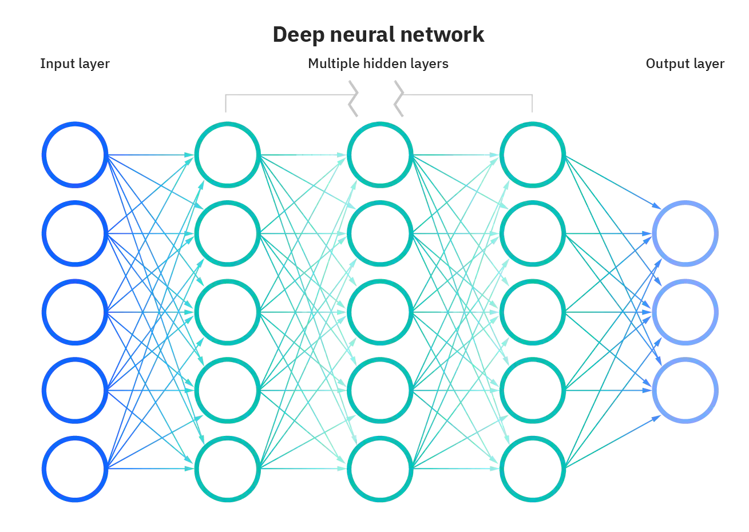
SHALLOW NEURAL NETWORK
SHALLOW NEURAL NETWORK
W=0.5
Notes:
Each connection from one unit to another will have it own assign wight which is number between 0 and 1, it represent the strength of the connection between the units

Slide 9
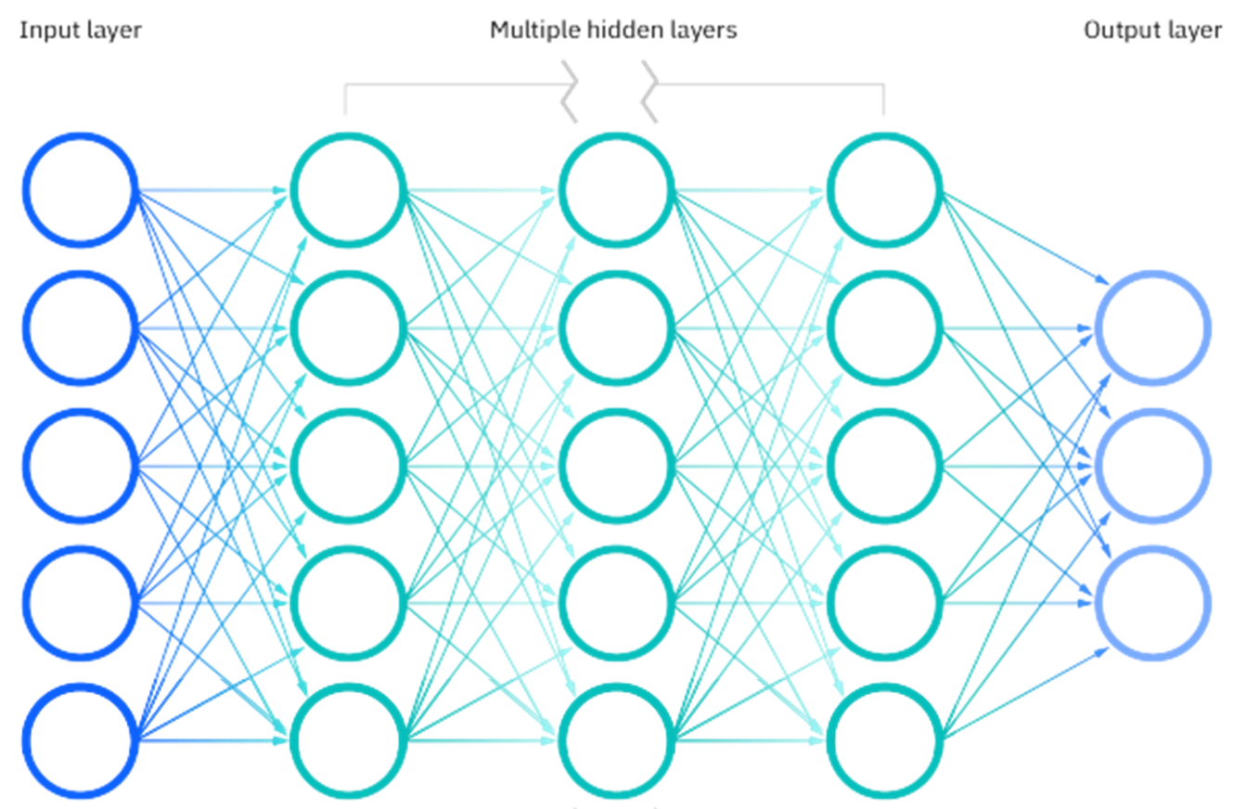
Deep Neural Network
Notes:
Each connection from one unit to another will have it own assign wight which is number between 0 and 1, it represent the strength of the connection between the units

Slide 10

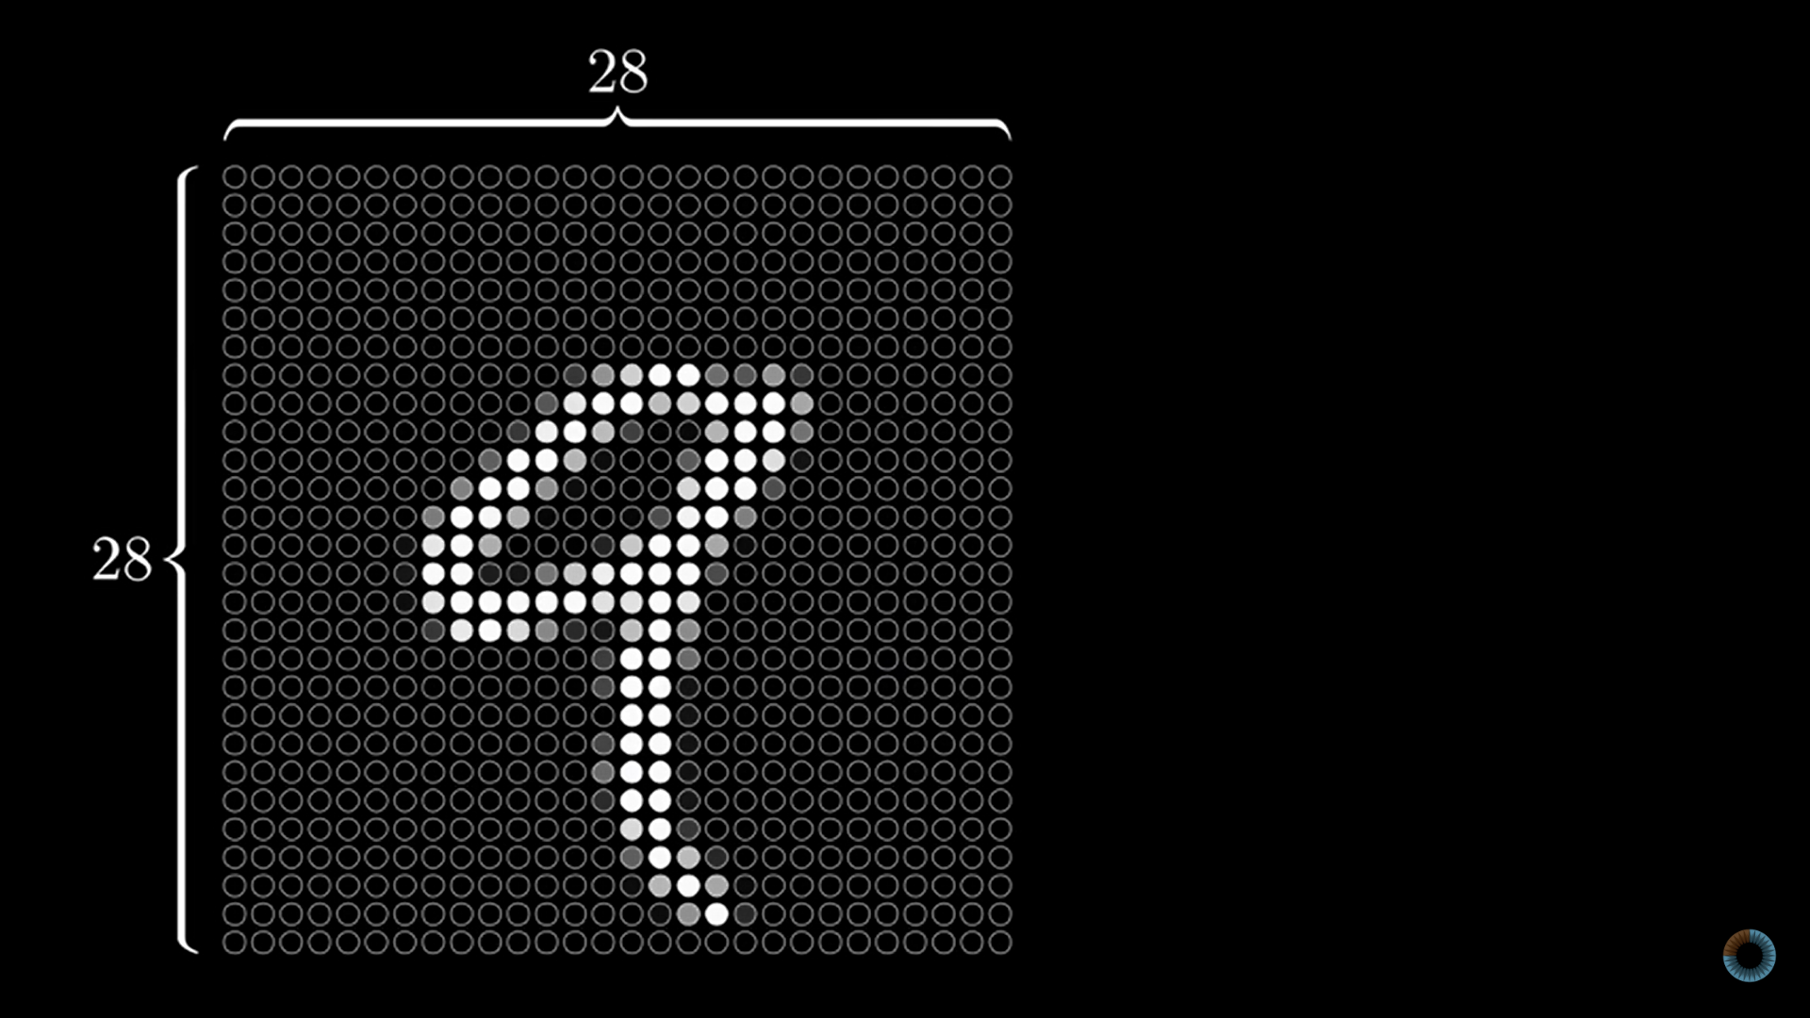

Input layer
28
28 x 28 = 784 Neural
28
Activation
Notes:
Add video instead this

Slide 11
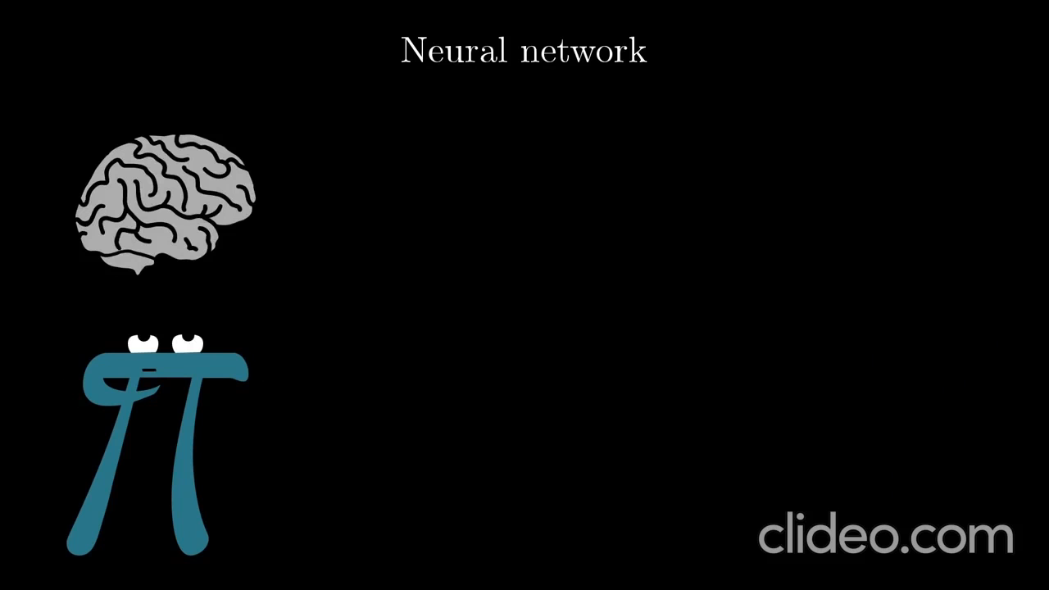

Slide 12





Hidden layer
located between the input and output of the algorithm
Activation function
decides whether a neuron should be activated or not
Most of the data processing is carried out in the hidden layers
act as a threshold function
Notes:
For example : if its zero it will not work , and if it 1 it will work

Slide 13



Output Layer
The final layer in the neural network
Can solve classification and regression problems
Notes:
For example : if this model have a task that decided wither the number is 9 or 1 so our output will have two units representing two possible output

Slide 14
Question
Which of the following statements does not hold true?
A
Activation functions are threshold functions
B
Error is calculated at each layer of the neural network
C
Most of the data processing is carried in the hidden layers
Notes:
Error is always calculated at output layer and then weight are adjusted to provide accurate results next time as application trains by itself"
73
Reply

Slide 15



How To
Setting up the data

Slide 16



Weight Initialization
Prevents layer activation outputs from exploding
Can lead to a very slow convergence or an inability to coverage if not initialized.
Notes:
# by default, initialized to “golort uniform”

Slide 17
Techniques
Zero initialization
Normalized Xavier/Glorot initialization
Random initialization
He uniform initialization
Xavier/Glorot initialization
He normal initialization

Slide 18
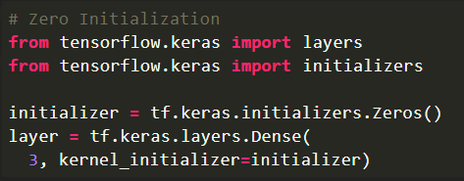
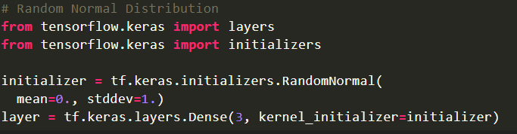
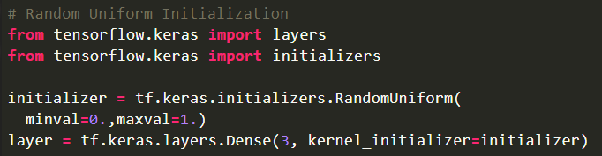
Zero initialization
Random
Random Normal
Random Uniform
Notes:
Zero:
As the name suggests, all the weights are assigned zero as the initial value is zero initialization. This kind of initialization is highly ineffective as neurons learn the same feature during each iteration. Rather, during any kind of constant initialization, the same issue happens to occur. Thus, constant initializations are not preferred.
Random:
In an attempt to overcome the shortcomings of Zero or Constant Initialization, random initialization assigns random values except for zeros as weights to neuron paths. However, assigning values randomly to the weights, problems such as Overfitting, Vanishing Gradient Problem, Exploding Gradient Problem might occur.
Rand norm: The weights are initialized from values in a normal distribution
Rand uniform: The weights are initialized from values in a uniform distribution

Slide 19

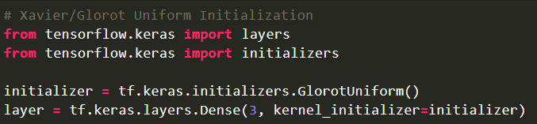
Xavier/Glorot Initialization
Suitable for layers where the activation function used is SIGMOID
The weights are assigned from values of a uniform distribution

Slide 20
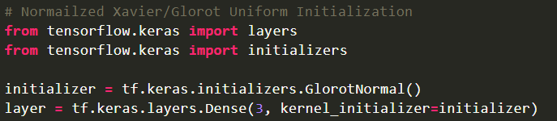


Normalized Xavier/Glorot initialization
Xavier/Glorot Initialization, too, is suitable for layers where the activation function used is Sigmoid.
In Normalized Xavier/Glorot weight initialization, the weights are assigned from values of a normal distribution as follows:
Here, σ is given by:

Slide 21
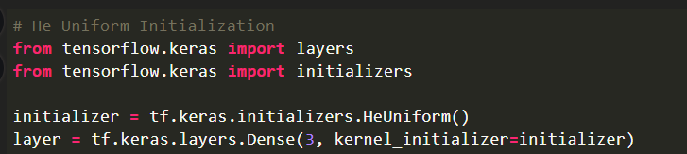
He Uniform Initialization
He Uniform Initialization is suitable for layers where ReLU activation function is used.
In He Uniform weight initialization, the weights are assigned from values of a uniform distribution as follows:

Slide 22


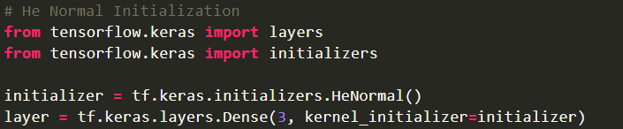
He Normal Initialization
He Uniform Initialization, too, is suitable for layers where ReLU activation function is used.
In He Normal weight initialization, the weights are assigned from values of a normal distribution as follows:
Here, σ is given by:

Slide 23

Batch AND Epoch
Batch: Is the number of samples that will be passed through to the network at one time.
Epoch: Is a hyperparameter that defines the number times that the learning algorithm will work through the entire training dataset.
Notes:
Common
They are both integer values and they are both hyperparameters for the learning algorithm.
You must specify the batch size and number of epochs for a learning algorithm.
There are no magic rules for how to configure these parameters. You must try different values and see what works best for your problem.

Slide 24
COMPARISON
Batch
Epoch
Number of samples processed before the model is updated.
Number of complete passes through
the training dataset.
The number of epochs can be set to an integer value between one and infinity.
The size must be between one and number of samples in the training dataset.

Slide 25
Batch Normalization
Is a method used to make training of artificial neural network Faster and more stable through normalization of the layers' inputs by re-centering and re-scaling.
Notes:
(also known as batch norm)

Slide 26
Advantages of Batch Normalization
Used to faster learning rates since normalization ensures there’s no activation value that’s too high or too low, as well as allowing each layer to learn independently of the others.
Normalizing inputs reduces the “dropout” rate, or data lost between processing layers. Which significantly improves accuracy throughout the network.

Slide 27
What is overfitting?

Slide 28
Data Augmentation
The process of transforming images to create new ones.
prevent overfitting, which helps improve the model performance.
makes a sample data look slightly different every time the model processes it.

Slide 29


Data Augmentation Techniques
Flipping
Cropping
Rotation
Brightness
Translation

Slide 30
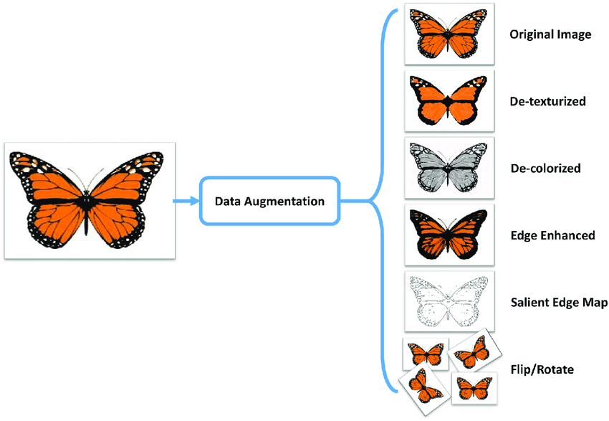
04

Slide 31




“You can’t improve what you can’t measure”

Slide 32


Loss function
The loss function is a method of evaluating how well your algorithm is modeling your dataset.
MSE
The simplest and most common loss function.
Also called an error function
The good model has a low value of the loss function
Cost function and loss function are different.
Notes:
Loss function: is for a single training input
Cost function: is the average loss over the entire training dataset

Slide 33


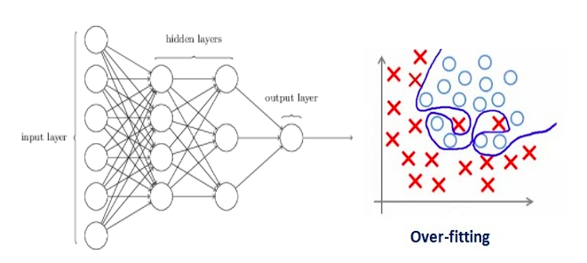
Regularization
A set of different techniques that lower the complexity of a neural network model during training and thus prevent the overfitting.
There are three very popular and efficient techniques called L1, L2, and dropout.

Slide 34
L2 regularization
Is the most common type of all regularization techniques
Performing L2 regularization encourages the weight values towards zero (but not exactly zero)

Slide 35
L1 regularization
It is very useful when we are trying to compress our model
Encourages the weight values to be zero

Slide 36
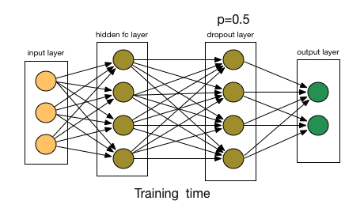
Dropout regularization
Notes:
This is the one of the most interesting types of regularization techniques
It produces very good results and is consequently the most frequently used regularization technique in the field of deep learning

Slide 37
Thank You

